Slide 1

By: Lu Zhenyang

Slide 2
Independent Variables
Registered Unemployment Rate(RUR)
Gross National Savings (GNS)
General Government Gross Debt (GGD)
Consumer Price Index (CPI)

Slide 3
Independent Variables cont..
  Fixed Assets Investment (UFA)
  Broad Money Supply(M2)
  Total of Import & Export (TIE)
  Shanghai Composite Index (SHI)
  Gross Domestic Product of USA(GUSA)
  Currency Rate of U.S. Dollar & Chinese Yuan (DDR)

Slide 4
Dependent Variable
  Gross Domestic Product of China (GDP)

Slide 5
Total
1 Dependent Variable
10 Independent Variables

Slide 6
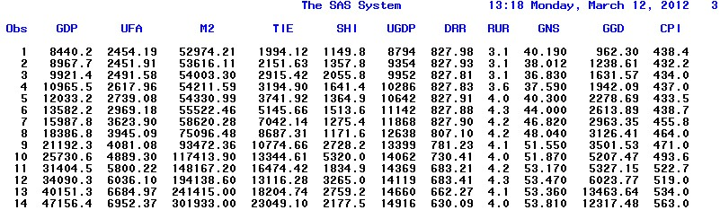

Slide 7
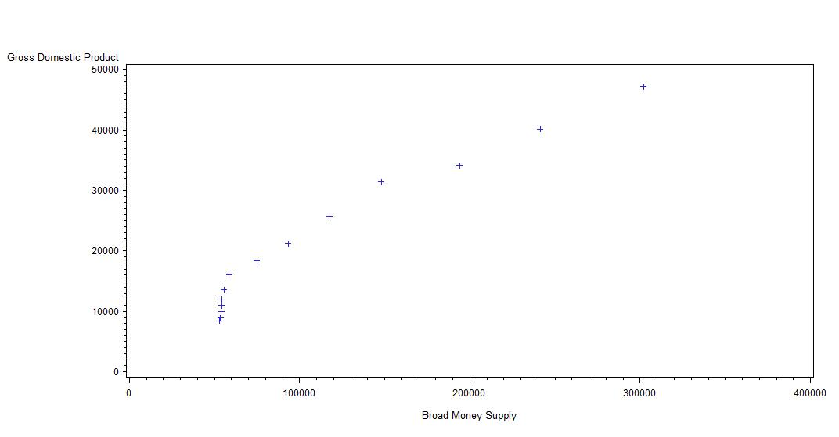
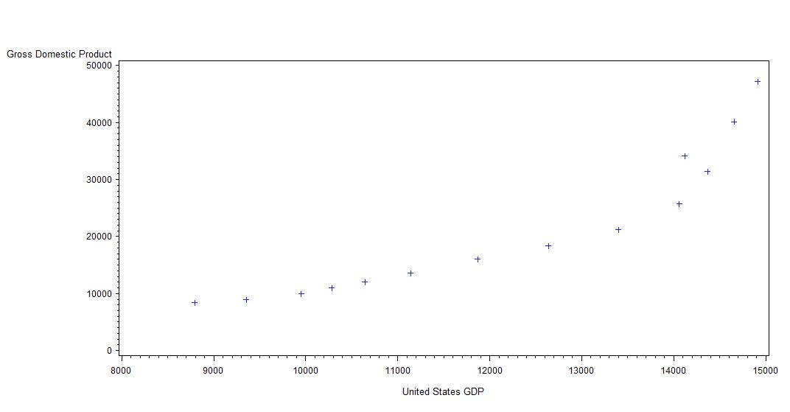
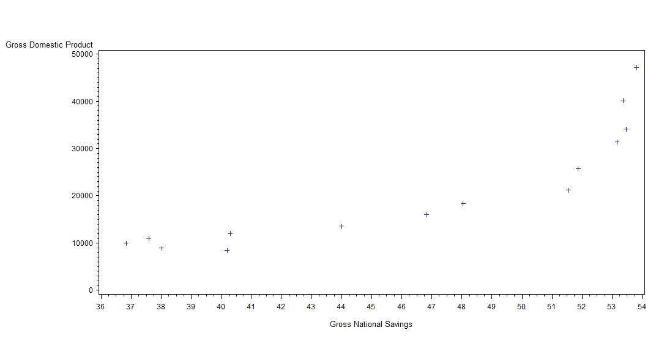
Regression Analysis

Slide 8
7 independent variables :
M2, SHI,TIE,GUSA, RUR, GNS, ,GGD
Not linear with the dependent variable.
-Mainly due to data from the economy, which is different
from Physics or natural science.

Slide 9
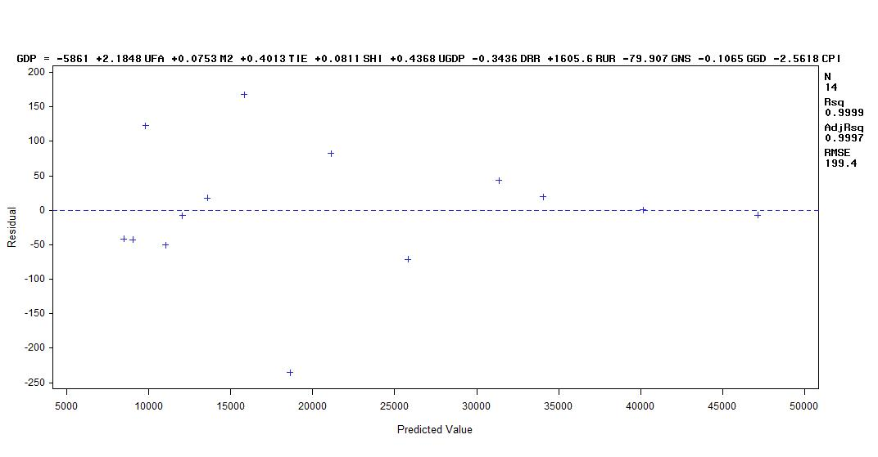
Residuals vs. Predicted Value
Shows heterscedastic relationship, because
Of this we used a natural log transform to the
Regression model.

Slide 10
Afterwards:
Used
  Forward
  Backward
  Stepwise Model Selection methods.
3 models were obtained.

Slide 11
-All 3 models behaved equally in terms of R-square, we kept
The parsimonious model, which is the Stepwise Selection
The output we got using STEPWISE SELECTION:
Summary of Stepwise Selection
Variable Variable Number Partial Model
Step Entered Removed Label Vars In R-Square R-Square C(p) F Value Pr > F
1 logtie 1 0.9818 0.9818 281.215 648.63 <.0001
2 logggd 2 0.0094 0.9912 133.083 11.71 0.0057
3 logrur 3 0.0030 0.9942 87.0603 5.16 0.0464
5 logm2 3 0.0045 0.9974 35.4016 17.42 0.0019
6 logcpi 4 0.0019 0.9993 6.5617 26.28 0.0006

Slide 12
-We decided to delete 3 variables that had the
Highest P-norm value, to make it short.
Values Deleted:
Log (GGD) – General Gov. Gross Debt
Log (CPI) - Consumer Price Index
Log (TIE) – Total of import & Export

Slide 13
After deleting variables, a Regression Equation was formed.
Log (GDP) = Log (M2) + Log (RUR)

Slide 14
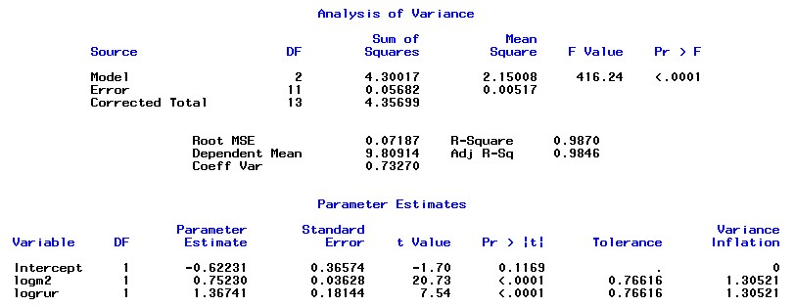

Slide 15
-Log(M2) and Log(RUR) have the best VIF!
-R2 is 98.7% of data that can be explained by equation.
-Global F-test is significant. F-value is 416.24, larger
then cutoff value.

Slide 16
Overall:
Indicate that if Broad Money Supply
and the Registered Unemployment Rate
Increase, China’s GDP will increase as well.
Sources:
International Monetary Bureau:
http://www.imf.org
National statistics Bureau of China:
http://www.stats.gov.cn

